Slide 1
Introduction to Neural Networks

Slide 2

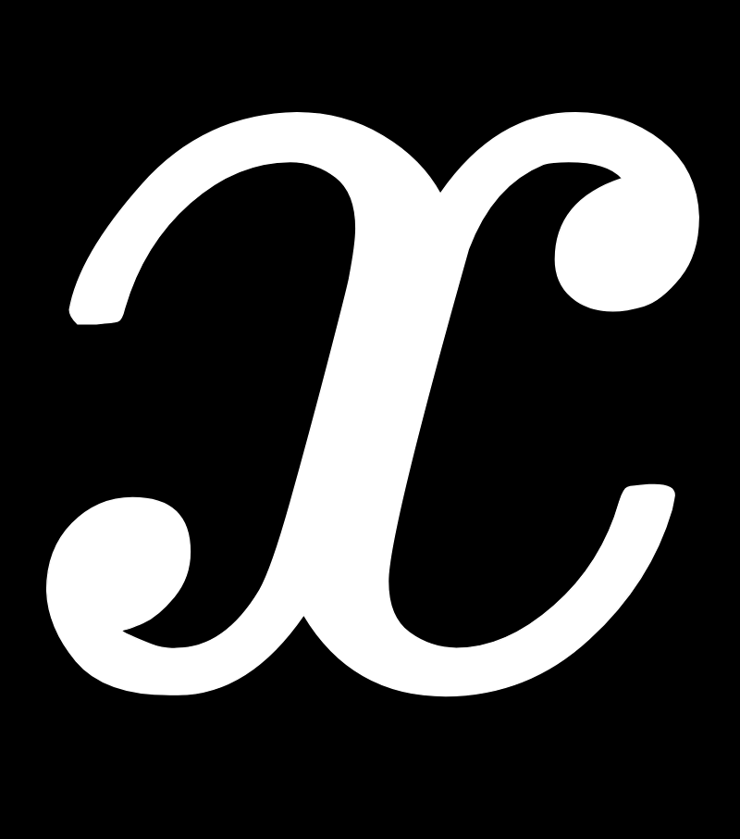
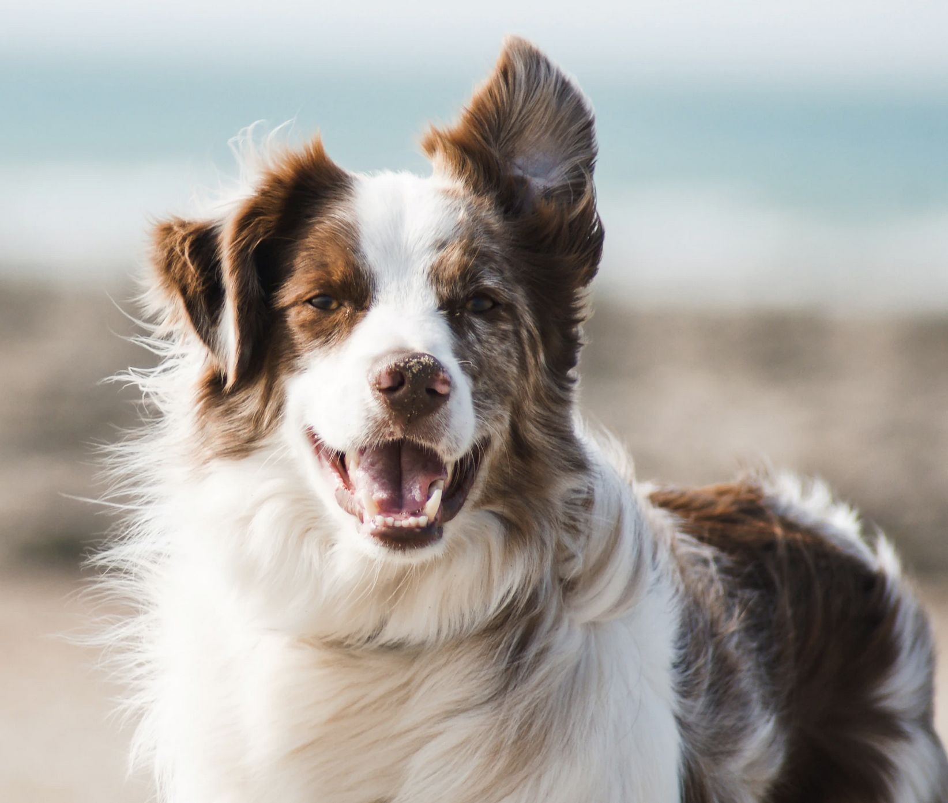
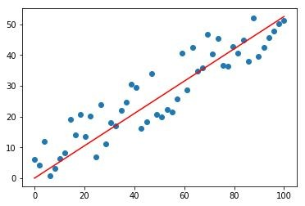
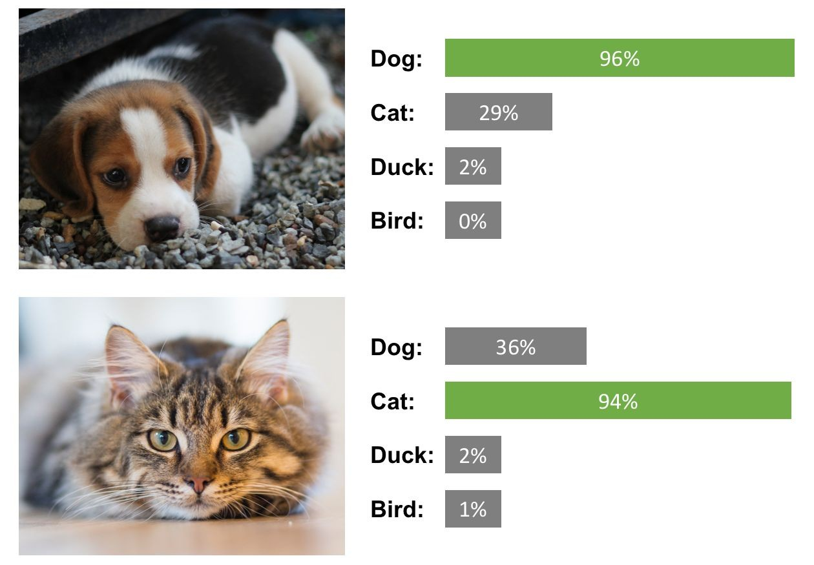

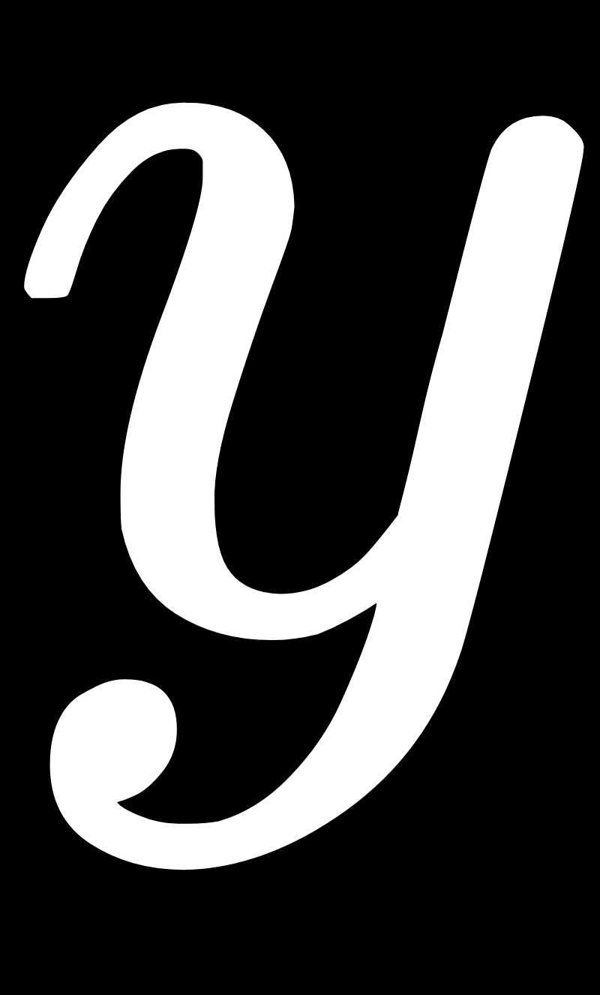

Supervised ML Background
Start with a set of “observations”
Supervised learning
Regression Classification
and a space of “targets” (or “labels”)
We are interested in ﬁnding a model that can map observations to determine its associated target (e.g. prediction, classiﬁcation etc).
2

Slide 3
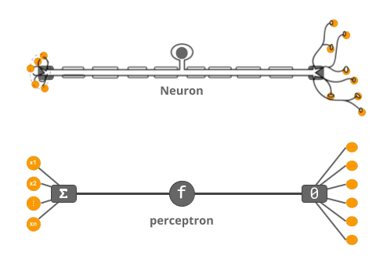
Neural:
Inspired by the way biological neurons work in the human brain
3

Slide 4
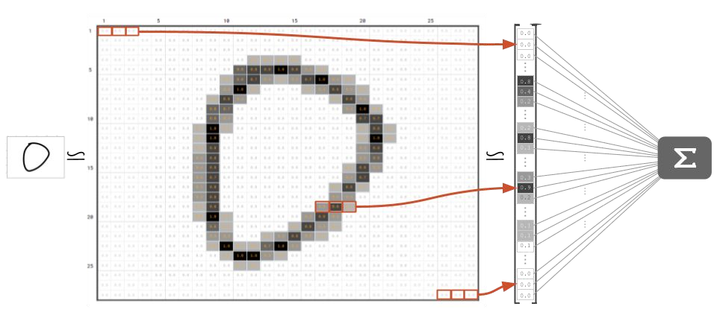
4

Slide 5
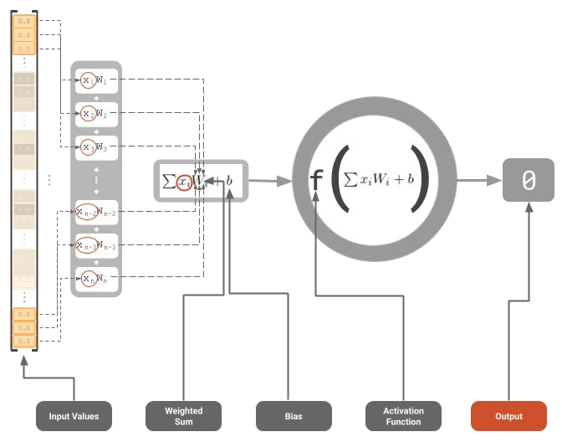
5

Slide 6
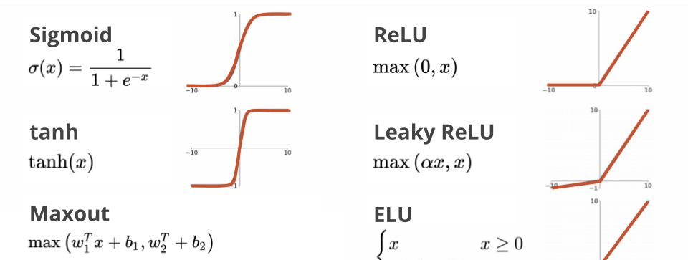
Activation functions
6

Slide 7
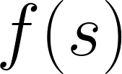








A Node
Sigmoid function
1
0
Weighted
Sum
Activation
Function
∙∙∙
ReLU function
0
7

Slide 8
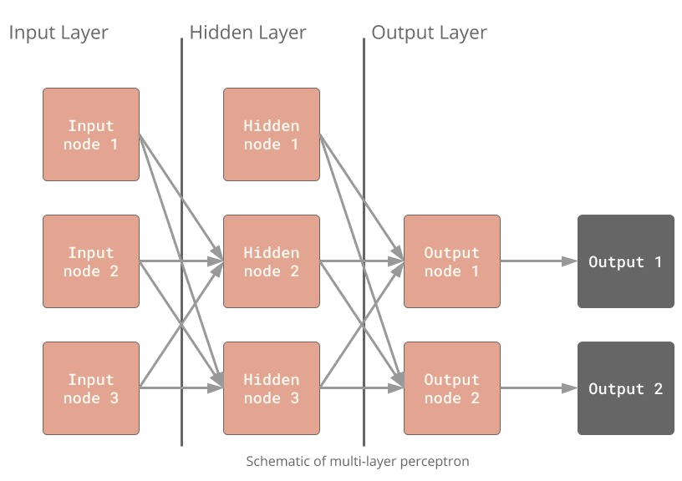
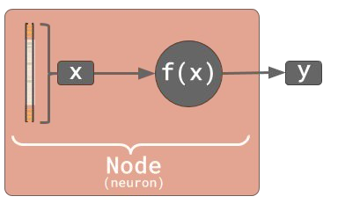
Neural:
Inspired by the way biological neurons work in the human brain process
Network:
A network of neurons/nodes connected by a set of weights
Bias 1
Bias 2
Input 1
Hidden node 1
Input 2
Hidden node 2
8

Slide 9
Training the Neural Networks
How does the network know what good weight values are?
9

Slide 10



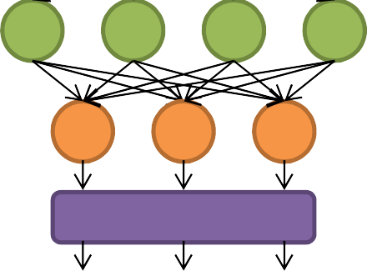

Training
Optimization: Gradient Descent
Initialize weights with random values
Input features from training sample
Perform forward pass
Calculate loss
Perform backpropagation
Repeat 2-5 until desired/acceptable performance
Softmax
P(class1) P(class2) P(class3)
10

Slide 11
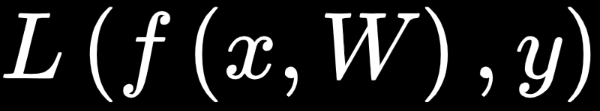
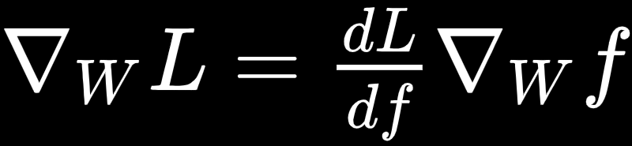
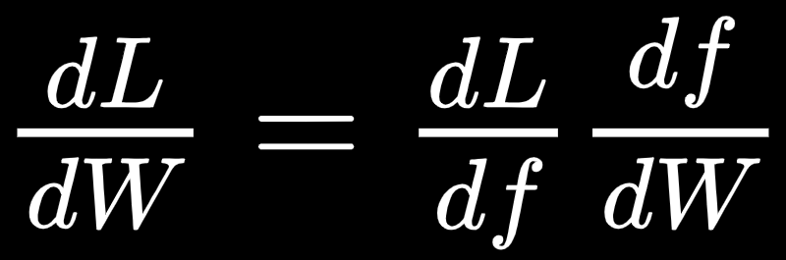
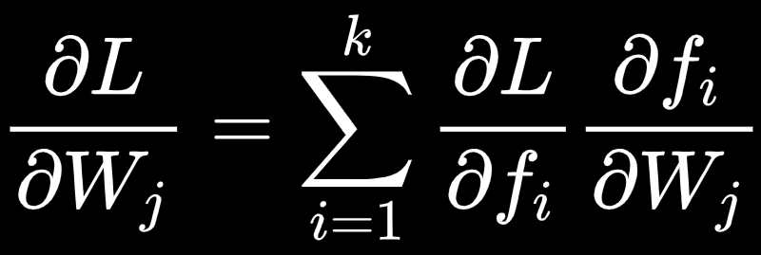
Backpropagation
Chain Rule
For input x, target y, and parameters W, our loss is of the form
if W is a vector of parameters, then
To compute the gradient of L with respect to W
we need the chain rule
if f is vector-valued with k values and W is a vector of m parameters
given f is single-valued, W a single parameter.
11
13

Slide 12
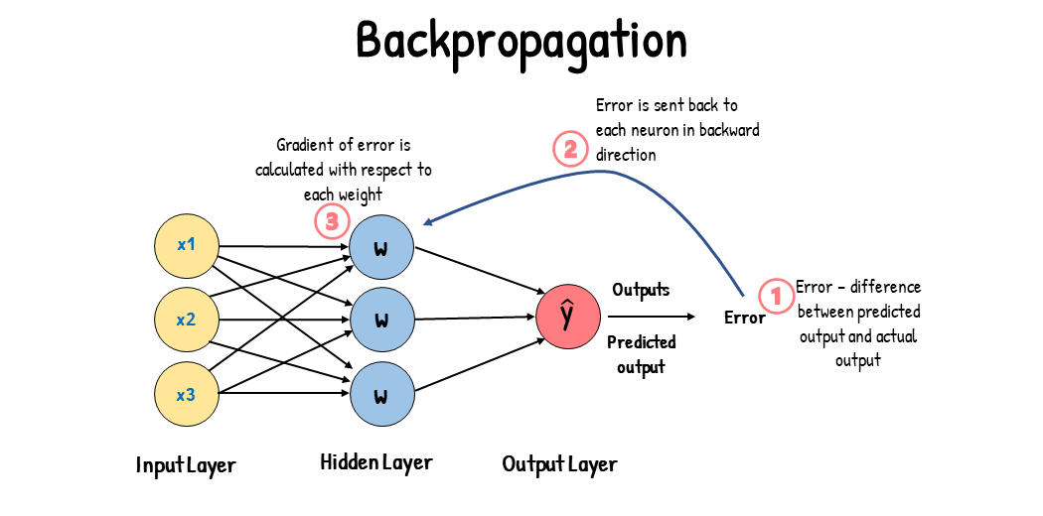

Slide 13
Spotting Underfitting and Overfitting
How To Measure Model Performance contd.
validation
training
Loss
Loss
Loss
validation
validation
training
0
0
training
0
Time (epochs)
Time (epochs)
Time (epochs)
Underfit: Model performs poorly on training and validation data
Good fit: Model generalizes well from training to validation data
Overfit: Model predicts training data well but fails to generalize to validation data
13

Slide 14
Spotting Underfitting and Overfitting
How To Measure Model Performance
100%
100%
training validation
100%
training
validation
Accuracy
Accuracy
Accuracy
training
0%
validation
0%
0%
Time (epochs)
Time (epochs)
Time (epochs)
Underfit: Model performs poorly on training and validation data
Good fit: Model generalizes well from training to validation data
Overfit: Model predicts training data well but fails to generalize to validation data
14

Slide 15
Terminology
Gradient descent: Algorithm to adjust parameters in a model to minimize loss during backpropagation
Epoch: All training samples have been passed through the model to compute the loss and gradient(s)
Batch gradient descent: Update parameters with gradient descent once after computing the average gradient from all training data (1 iteration of gradient descent for 1 epoch)
Stochastic gradient descent (SGD): Update parameters with gradient descent once after computing the gradient from one training sample (1 iteration of gradient descent for 1 sample)
Mini-batch gradient descent: Update parameters with gradient descent once per group of training samples (1 iteration of gradient descent for 2..(n-1) samples, where n is the number of training samples.
15

Slide 16
Thank You!

